Slide 1
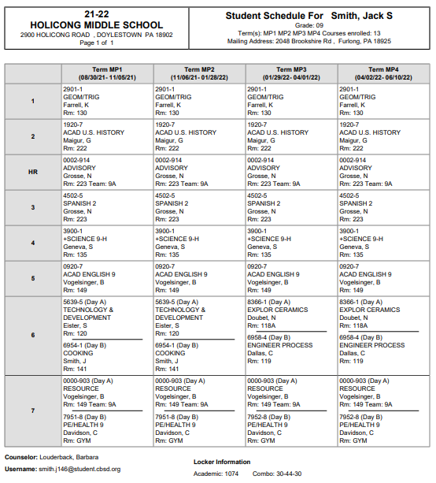
Student Name
Period | Time
1 | 7:30 – 8:20
2 | 8:23 – 9:13
Advisory | 9:16 – 9:35
3 | 9:38 – 10:28
LUNCH | 10:28 – 10:58
4 | 11:01 – 11:51
5 | 11:54 – 12:44
6 | 12:47 – 1:37
7 | 1:40 – 2:30
How to read a 9th Grade Schedule
Student email

